Slide 1

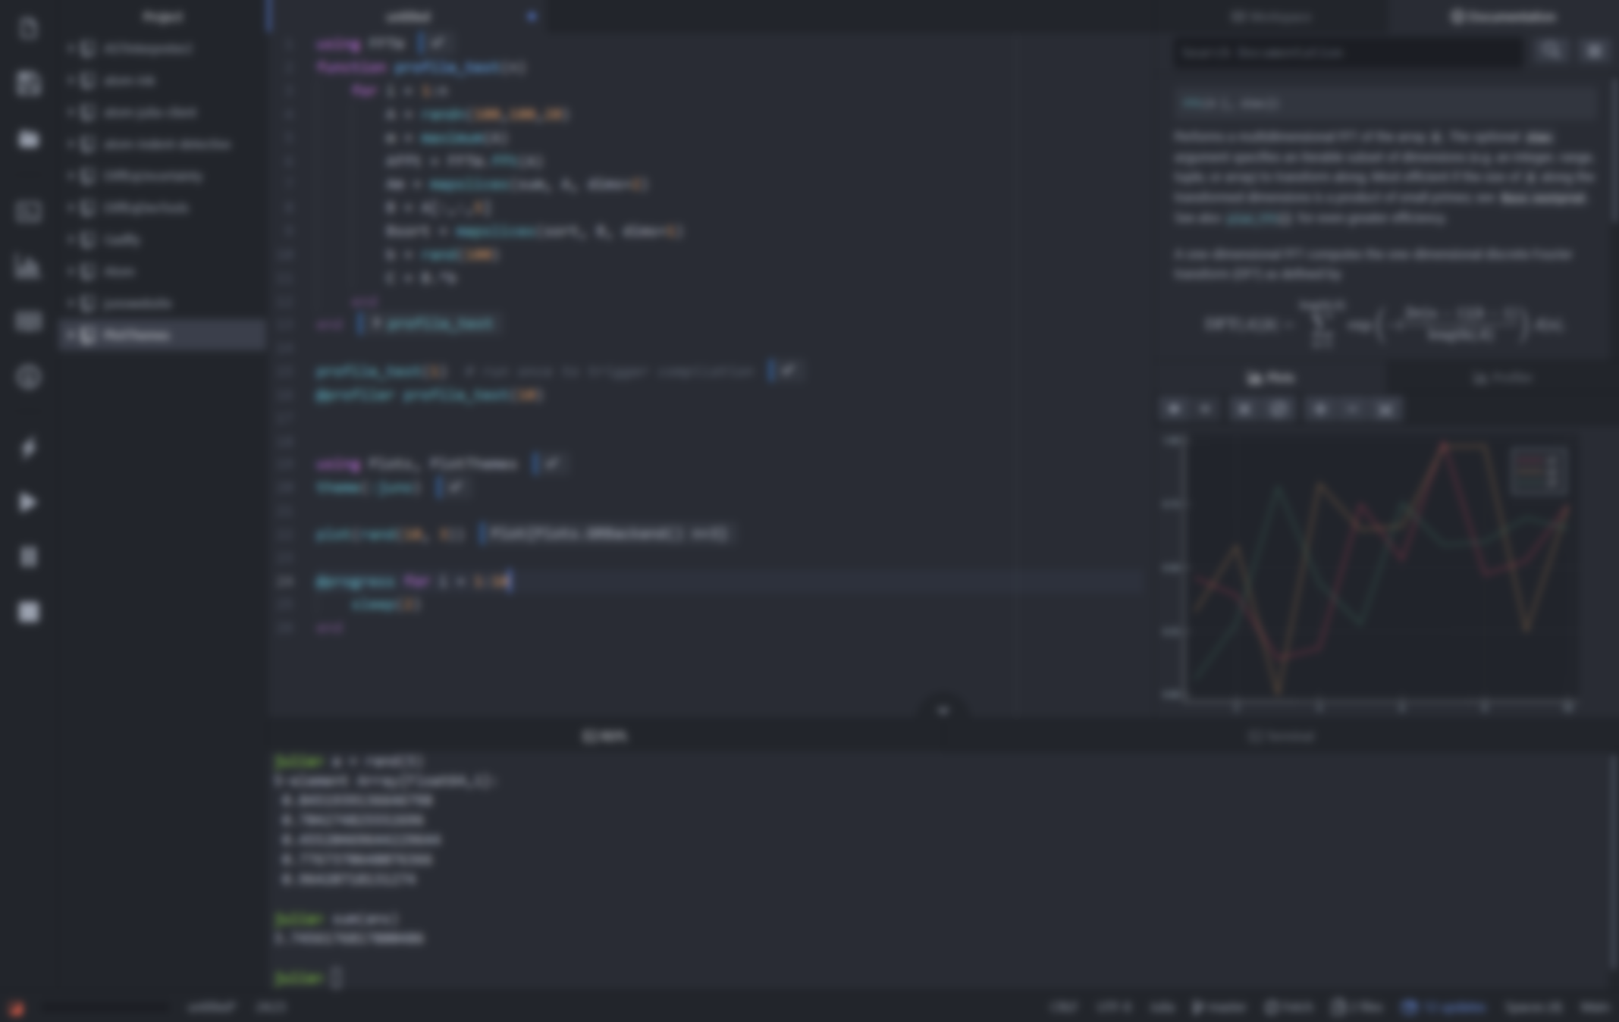



Advanced Julia Workshop
Carsten Bauer @ University of Cologne, October 2019

Slide 2
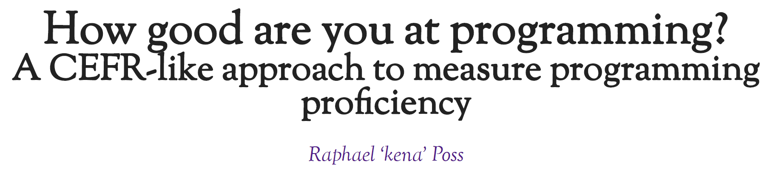
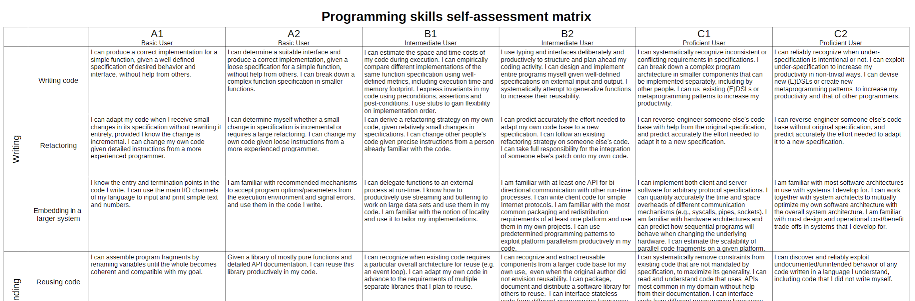
https://science.raphael.poss.name/programming-levels.html
A1 level
Workshop
B1 level
Notes:
Common European Framework of Reference for Languages – language proficiency

Slide 3
Workshop Schedule
 | Monday | Tuesday | Wednesday | Thursday | Friday
9:30 - 11:30 (2h) | Types + Dispatch | Environments + Julia Gotchas | Parallel Computing | Holiday | Hackathon + MiniWorkshops
 | Short break
11:45 - 12:45 (1h) | Custom types | Linear Algebra + Quantum Ising | Distributed
 | Lunch break
14:00 - 16:00 (2h) | Specialization + Generic Prog. | Machine Learning Physics | Tips&Tricks + Ecosystem

Slide 4
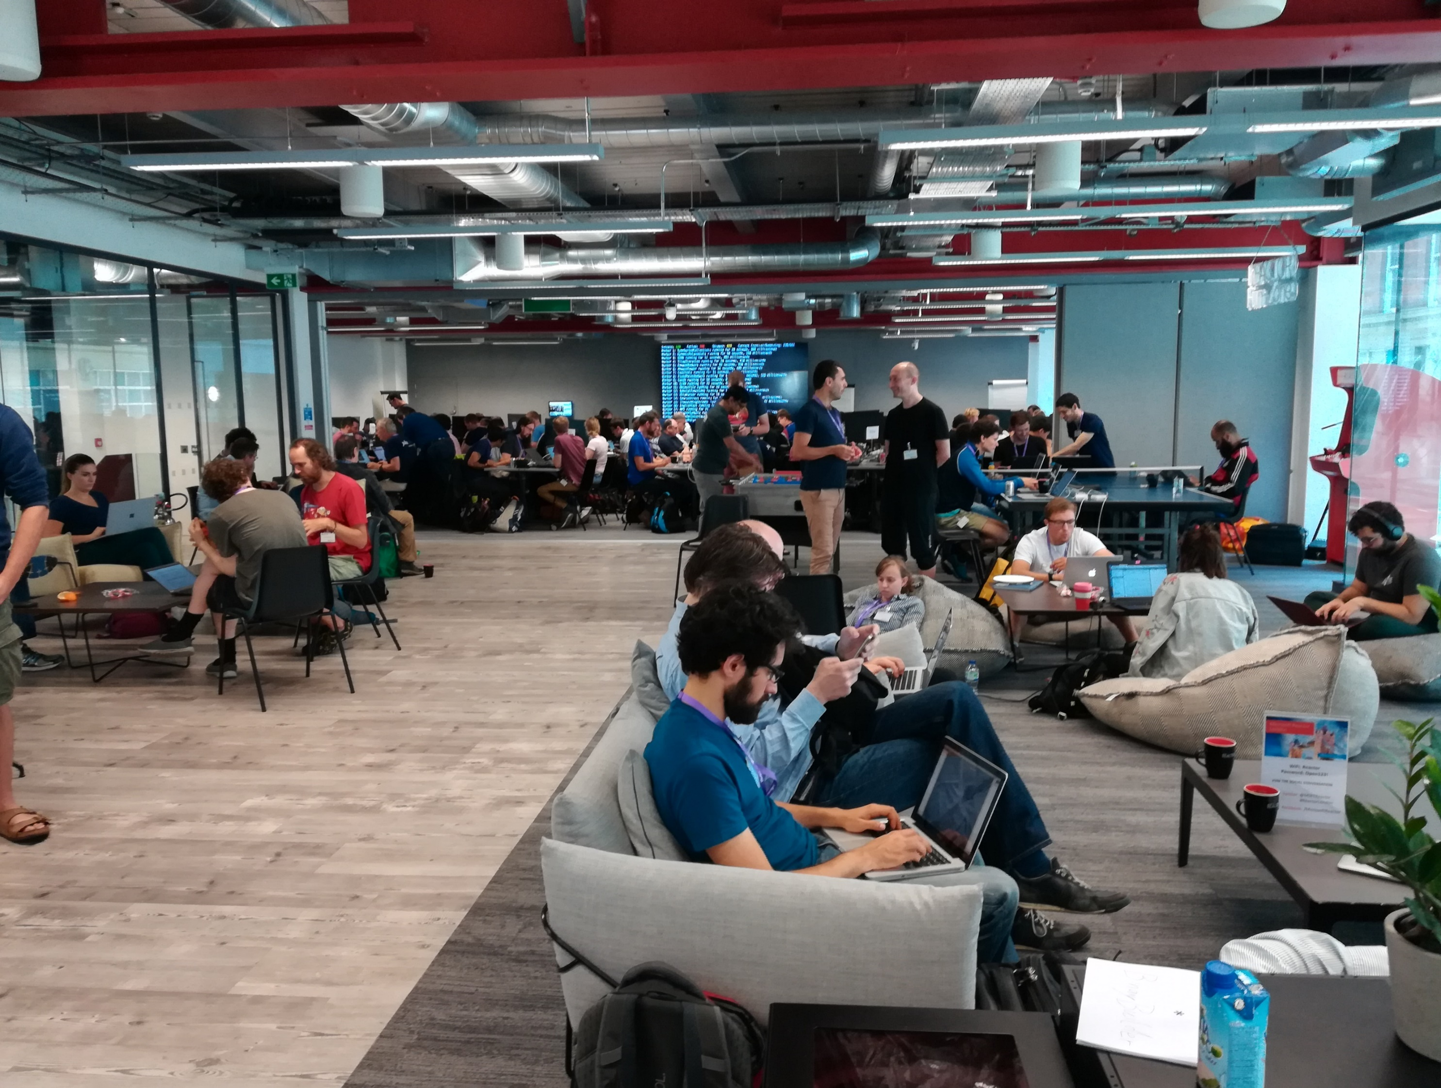



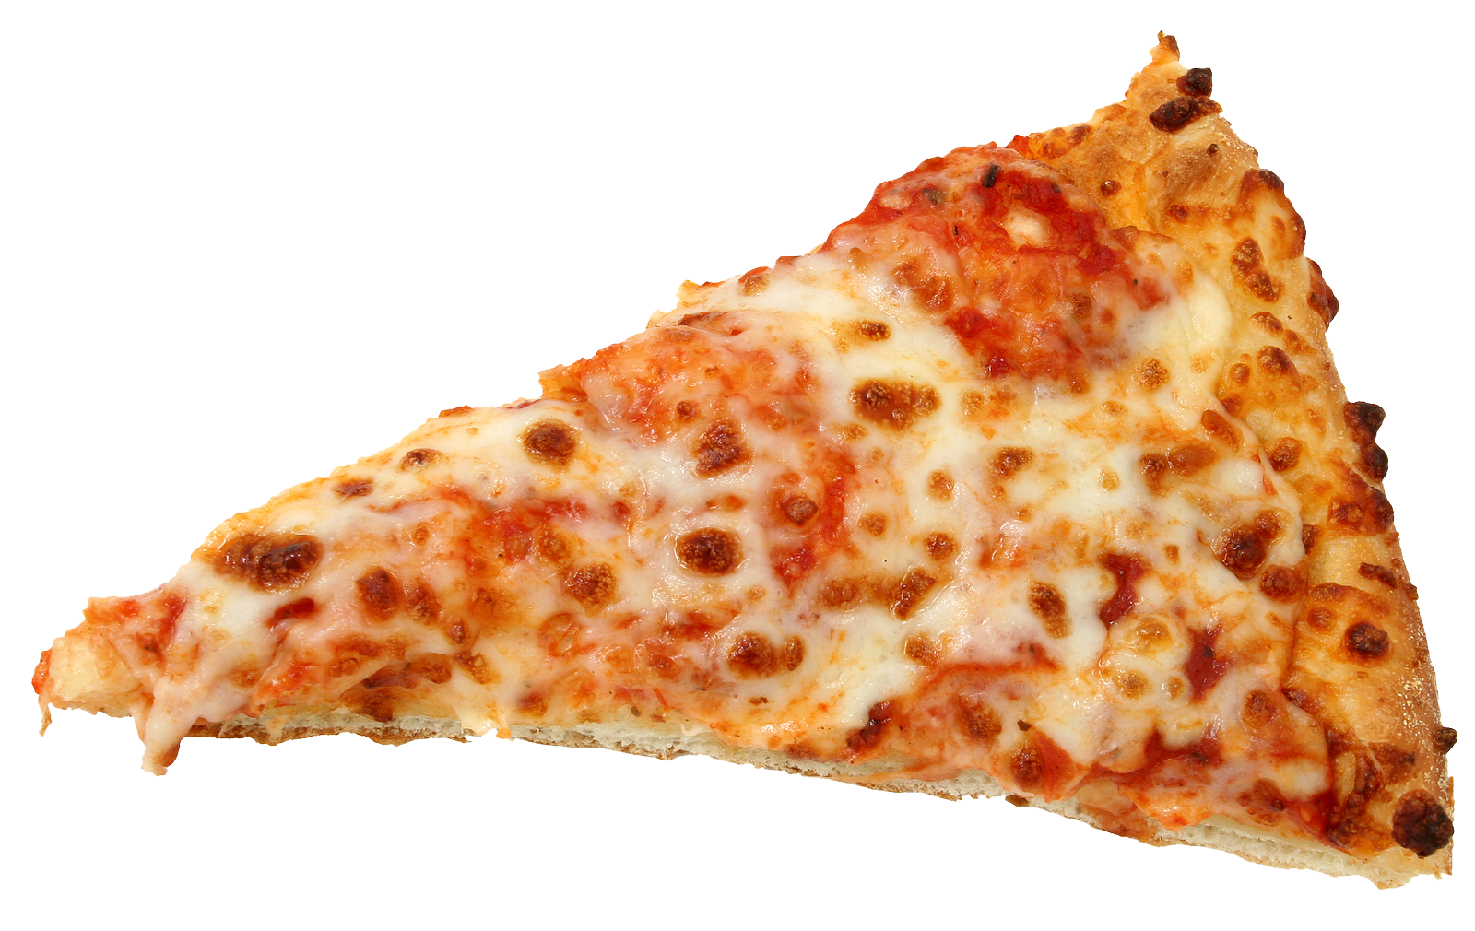

2018

Slide 5
Workshop materials
Terminal
git clone https://github.com/crstnbr/julia-workshop-2019
cd julia-workshop-2019
julia install_dependencies.jl

Slide 6
Workshop materials
Julia REPL
using Pkg
Pkg.GitTools.clone("http://tiny.cc/julia", "workshop")
cd("workshop")
include("install_dependencies.jl") # might take a while

Slide 7
Workshop materials
Browser
Download https://github.com/crstnbr/julia-workshop-2019/archive/master.zip
Unzip the file.
Open the Jupyter notebook install_dependencies.ipynb and execute the cells.

Slide 8
The programming language for scientists
Carsten Bauer @ University of Cologne, October 2019

Slide 9

Disclaimer
This workshop will be opinionated!
This workshop will be incomplete!
The topics will (likely) be too easy and too difficult!
There are other great languages out there!

Slide 10



What does science need from a programming language?
Easy to write and read
Fast and scalable
Interactive

Slide 11


What does science need from a programming language?
Easy to write, read, and understand
Fast and scalable
Interactive

Slide 12








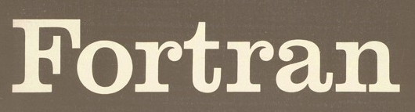
There’s a plethora of programming languages

Slide 13
There’s a plethora of programming languages

Slide 14
There’s a plethora of programming languages
Slow(ish)
Fast

Slide 15
There’s a plethora of programming languages
Compiled
Interpreted

Slide 16
There’s a plethora of programming languages
Static
Dynamic

Slide 17
There’s a plethora of programming languages
Speed
Convenience

Slide 18
The “two language problem”
a.k.a Ousterhout's dichotomy
Prototype
Production

Slide 19
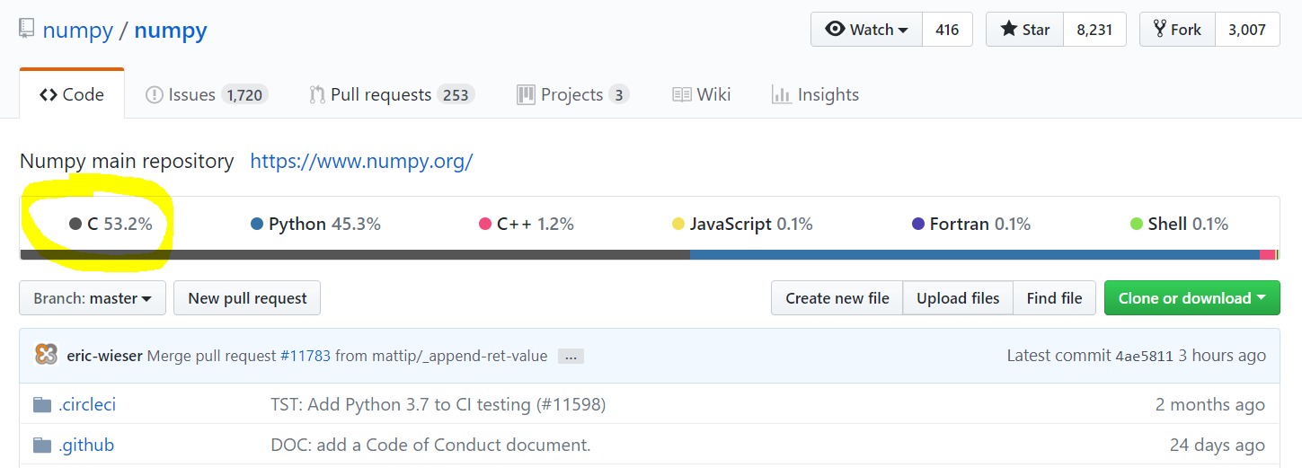
The “two language problem”

Slide 20

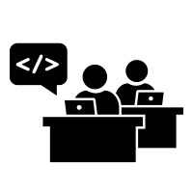

The “two language problem”
User
Developer

Slide 21
The “two language problem”
static
dynamic
compiled
interpreted
user types
standard types
standalone
glue

Slide 22

dynamic
compiled
user types
and
standard types
standalone
or
glue
“Feels like Python, runs like C”

Slide 23
What do we want from a PL?
The unification
Simple yntax + grammar
Simple syntax + grammar
Fast answers
Interactivity

Slide 24
What do we want from a PL?
The unification
function babylonian(α; N = 10)
@assert α > 0 "α must be > 0"
t = (1+α)/2
for i = 2:N
t = (t + α/t)/2
end
t
end
babylonian(π) ≈ √π
Simple syntax + grammar
Fast answers
Interactivity
“Feels like Python, runs like C”

Slide 25
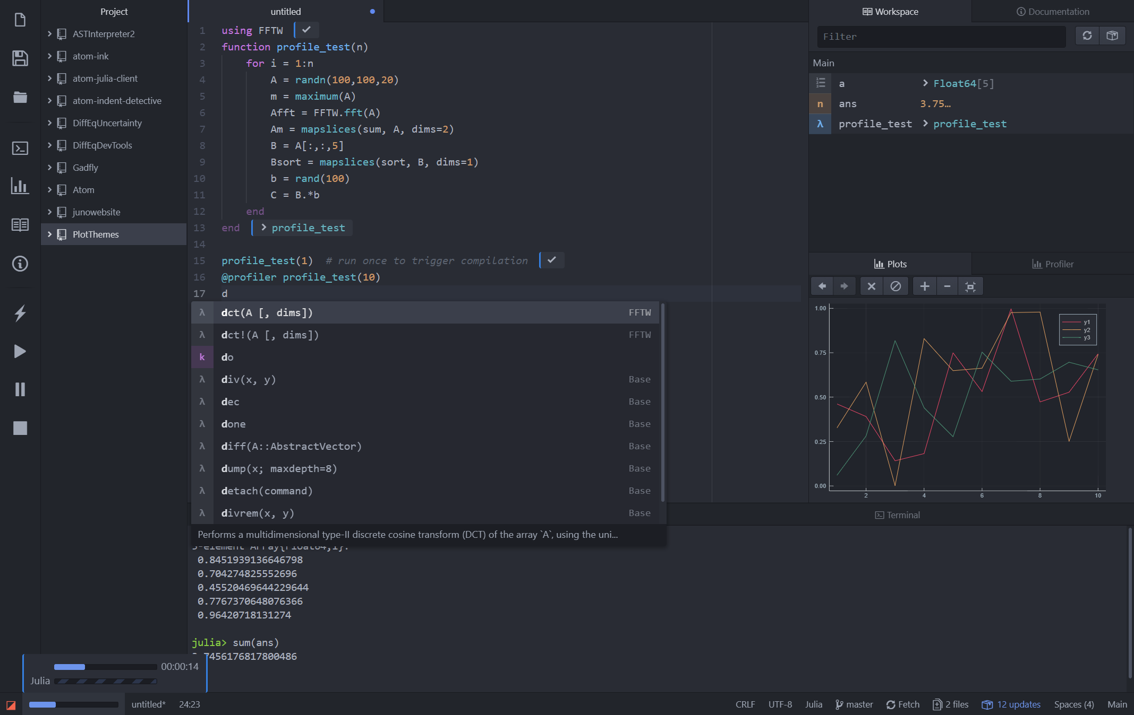
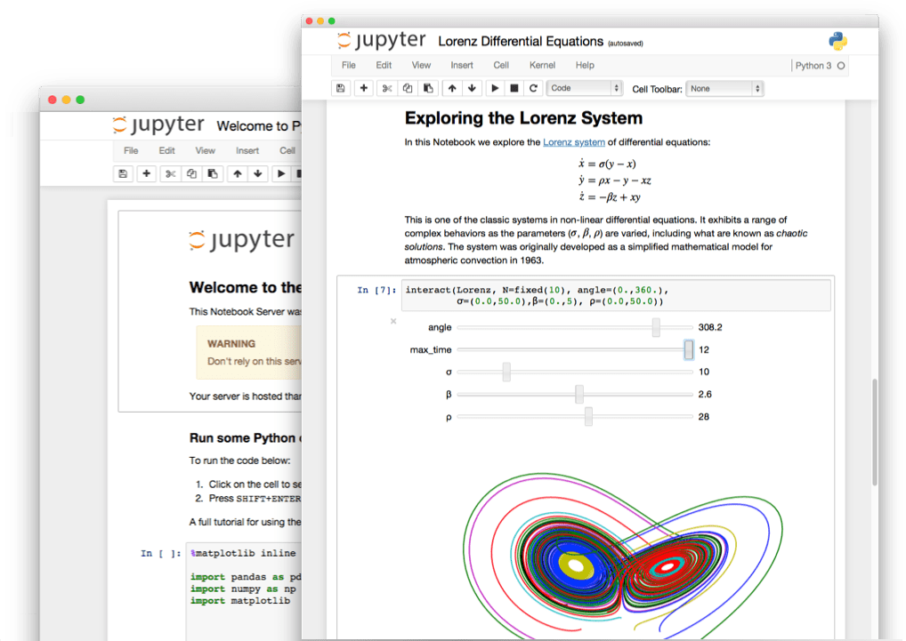
What do we want from a PL?
The unification
Simple yntax + grammar
Simple syntax + grammar
Fast answers
Interactivity
“Feels like Python, runs like C”

Slide 26
What do we want from a PL?
The unification
julia> function sumup()
x = 0
for i in 1:100
x += i
end
x
end
sumup (generic function with 2 methods)
julia> @code_llvm debuginfo=:none sumup()
; Function Attrs: uwtable
define i64 @julia_sumup_12626() #0 {
top:
ret i64 5050
}
Simple yntax + grammar
Simple syntax + grammar
Fast answers
Interactivity
Just returns the answer!
(The for loop was compiled away)
“Feels like Python, runs like C”

Slide 27
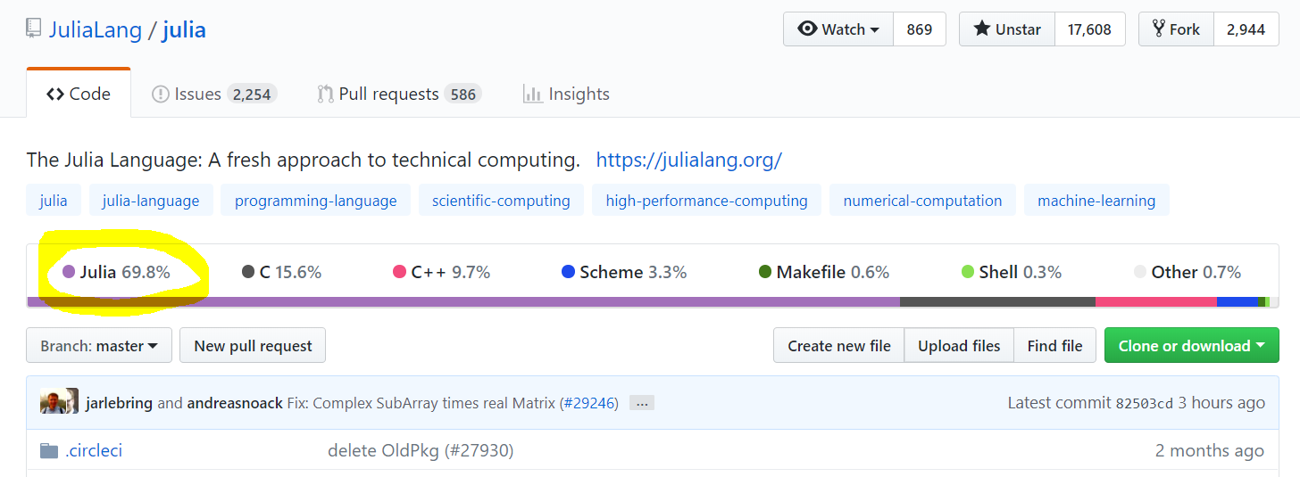
It is free and open source

Slide 28

It is inviting
User
Developer

Slide 29
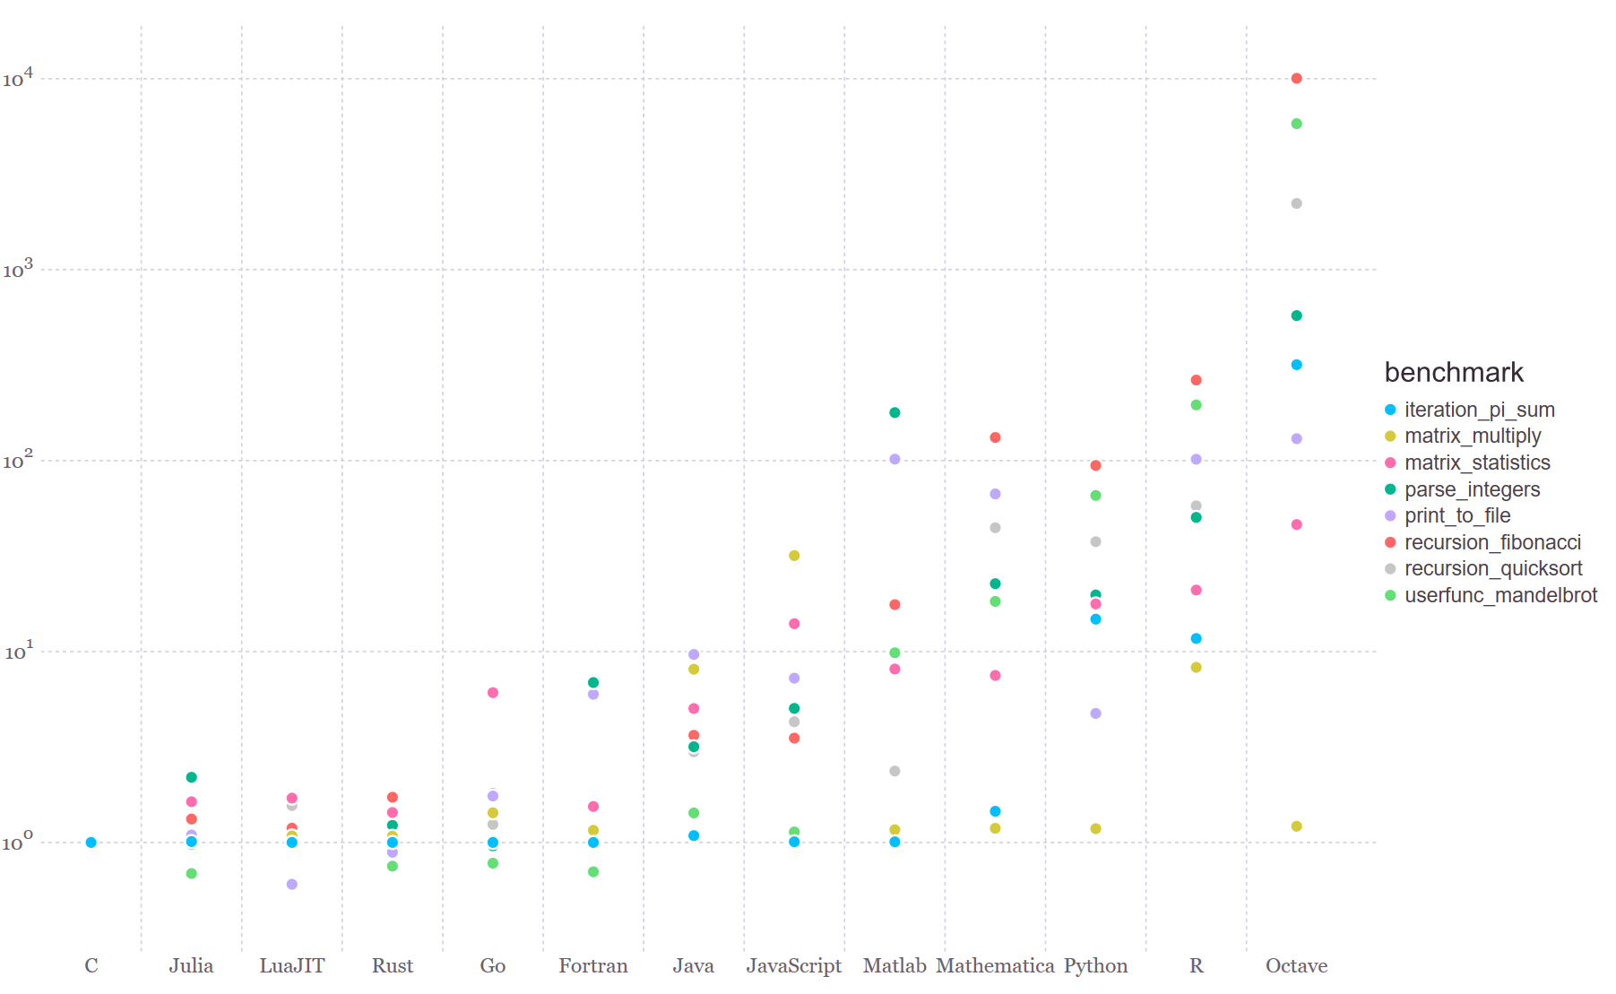
It is fast

Slide 30
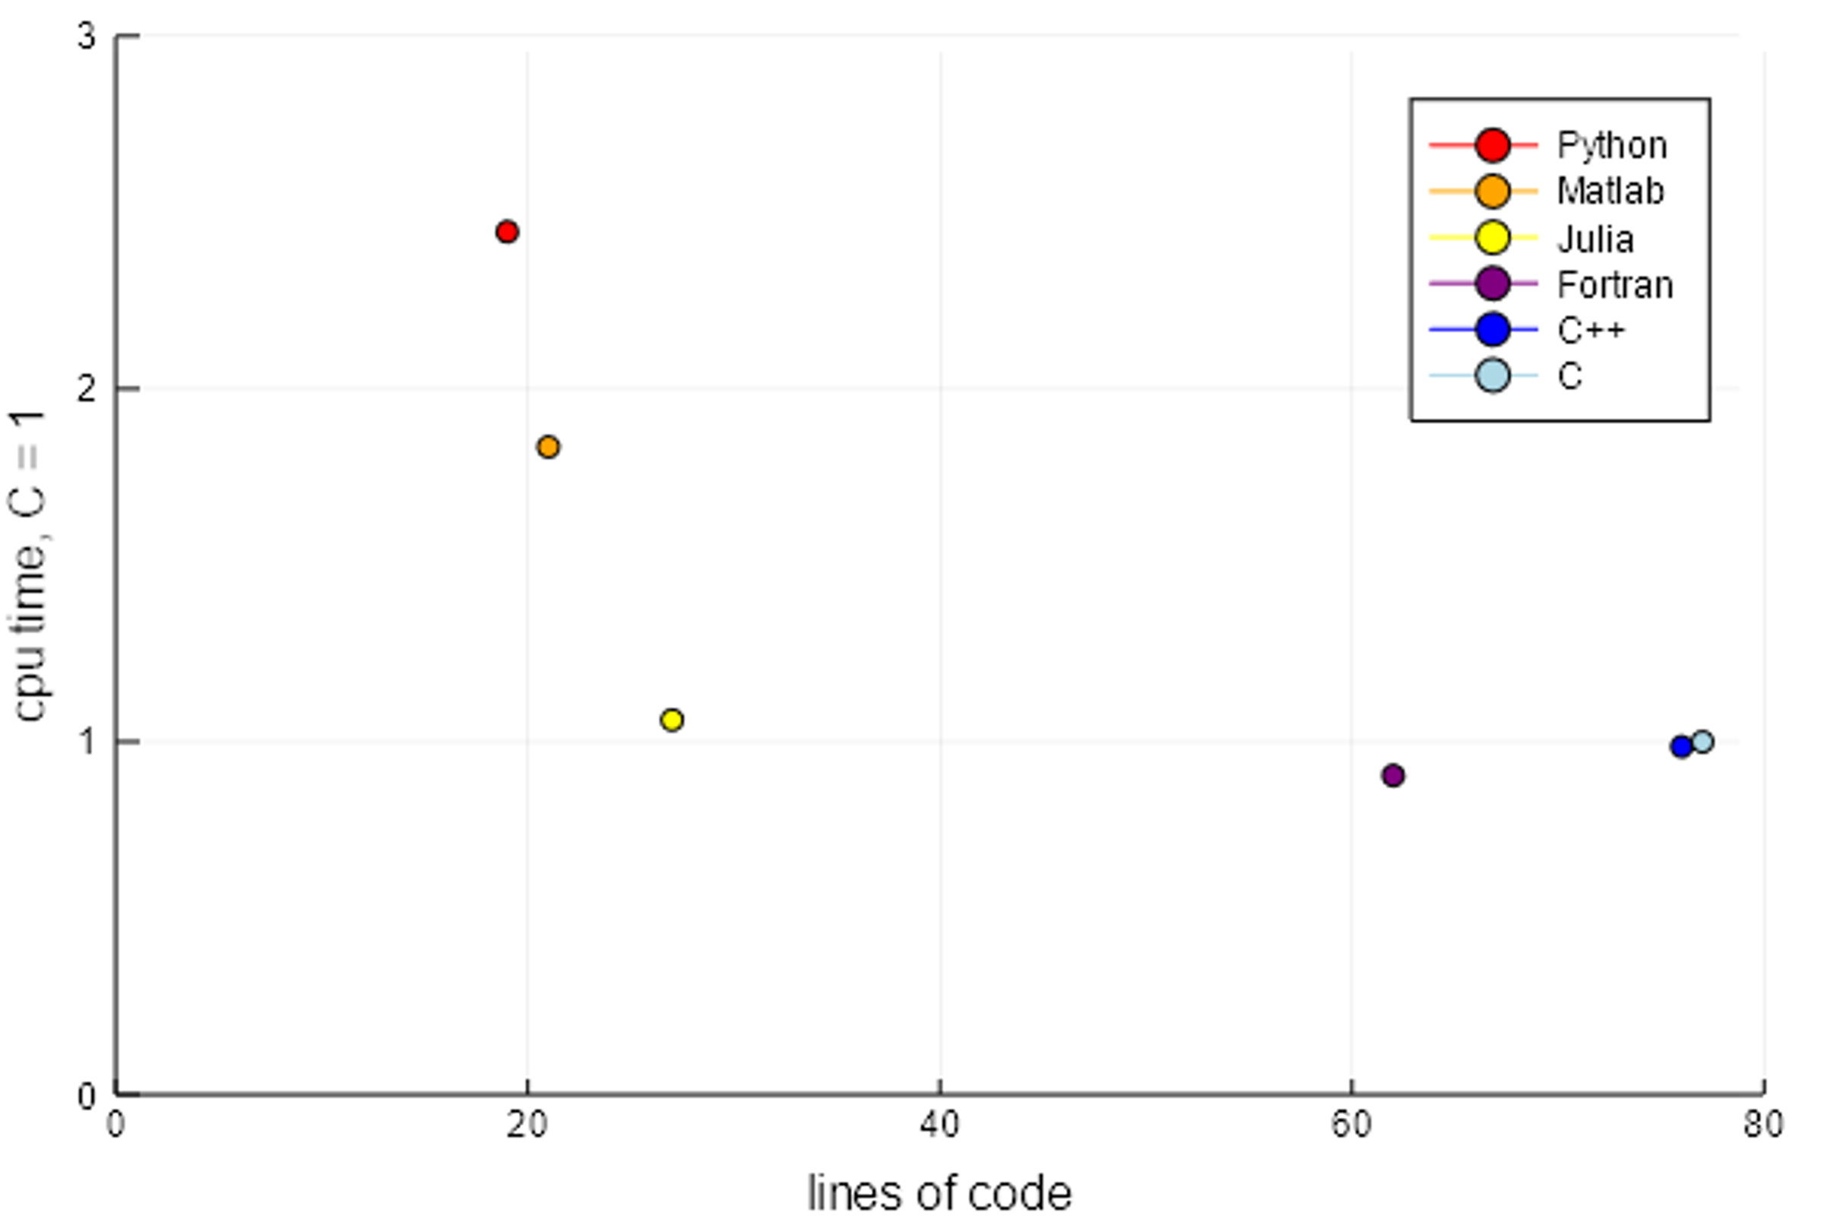
It is expressive

Slide 31
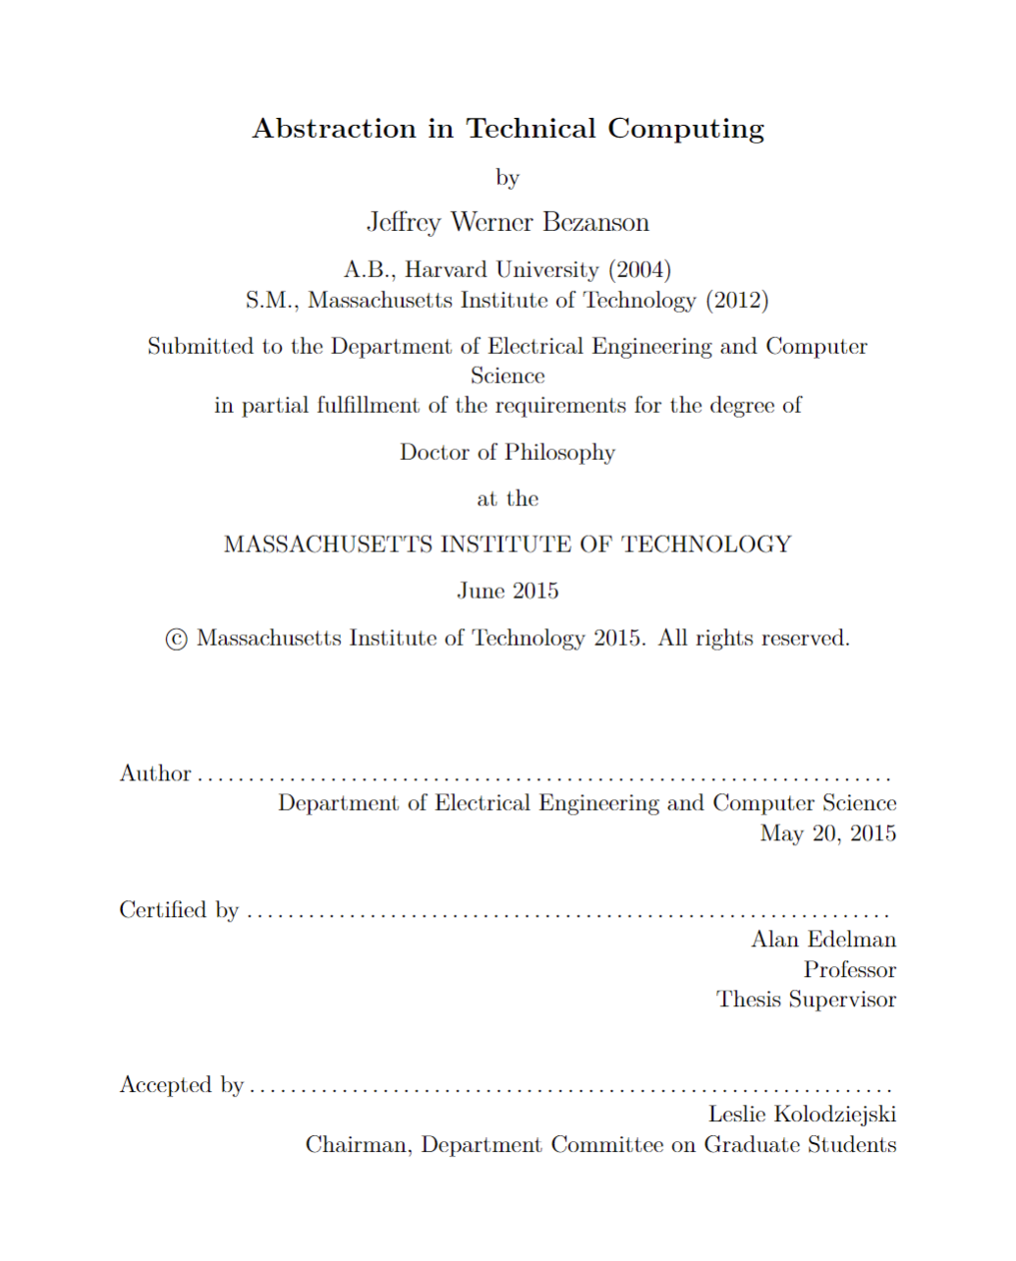
How old is Julia?
2009 Jeff, Stefan, Viral, and Alan start working on Julia
2012 Blog post: Why we created Julia
2015 Jeff’s PhD & JuliaComputing
2018 Julia 1.0
Founders talk @ JuliaCon 2018: https://www.youtube.com/watch?v=1jN5wKvN-Uk

Slide 32

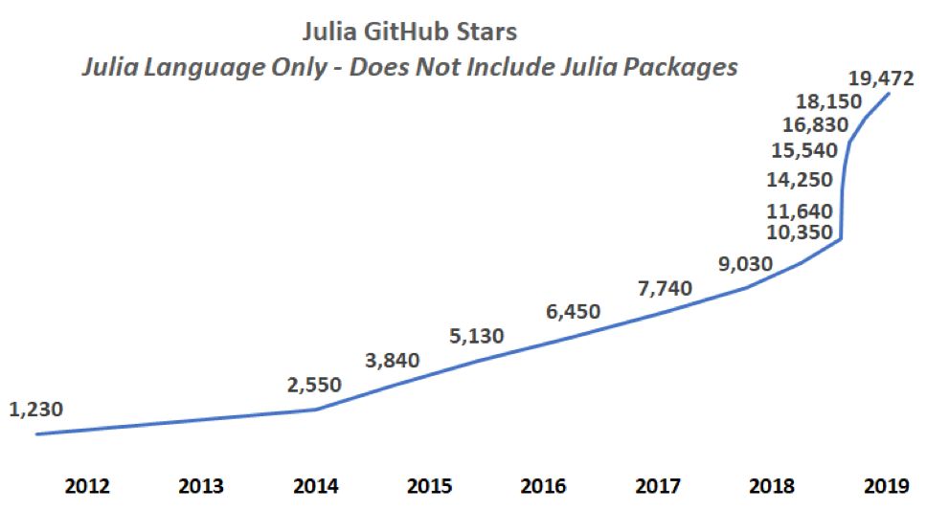
Julia stars
* Base language, does not include packages
https://juliacomputing.com/blog/2019/01/04/january-newsletter.html

Slide 33
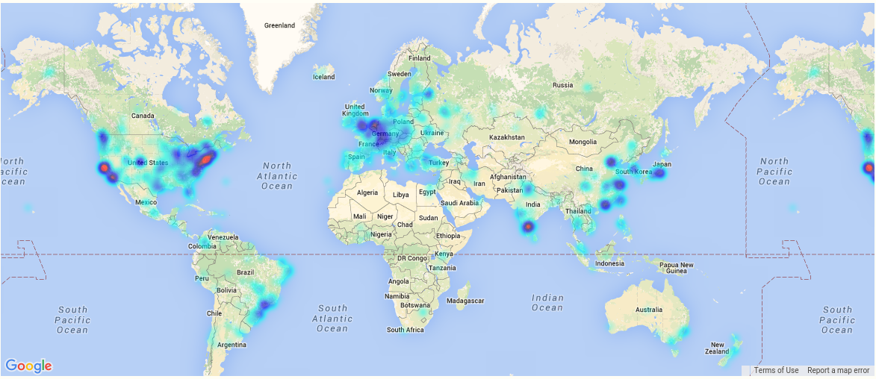
A global community
More than 3 Million downloads, 2500 packages

Slide 34
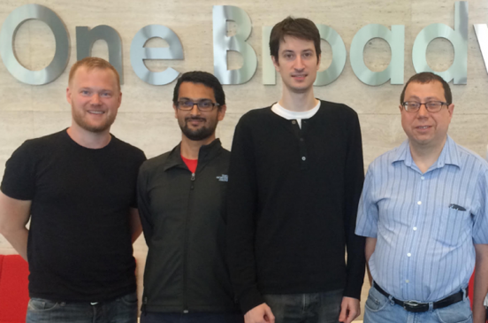
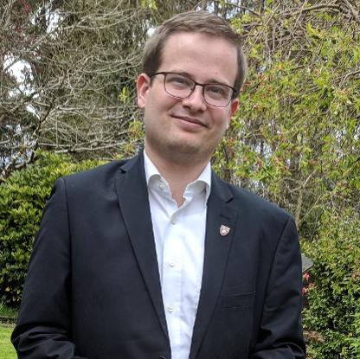
Stefan Karpinski
Viral B. Shah
Jeff Bezanson
(2019)
Keno Fischer
(2019)
Prof. Alan Edelman
(2018)
James H. Wilkinson Prize
For Numerical Software
Forbes
30 under 30
IEEE Babbage Prize
IEEE Fellow

Slide 35
James H. Wilkinson Prize
For Numerical Software
Forbes
30 under 30
IEEE Babbage Prize
IEEE Fellow
Stefan Karpinski
Viral B. Shah
Jeff Bezanson
(2019)
Keno Fischer
(2019)
Prof. Alan Edelman
(2018)

Slide 36































Notes:
Universities teaching Julia

Slide 37
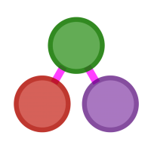
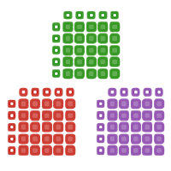





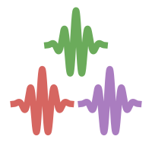
Best in class packages
Differential Equations
Graph Processing
Data Science
Image Processing
Deep Learning
Mathematical Optimization
Signal Processing
Computational Biology

Slide 38


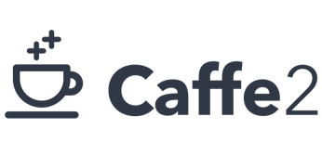


Knet.jl

Slide 39
Let’s dive right in!

Slide 40
Recommended talks
Nick Eubank: What Julia Offers Academic Researchers
George Datseris: Why Julia is the most suitable language for science

